Slide 1
Assessment
-Hareesh Kumaar G J
4362

Slide 2

1
We calculate the date difference by using the days() formula between Req date column and Wok Date column.
The difference is entered as a new column in the main data.
By using pivot table we take the average of the Difference of Date – 28.01

Slide 3
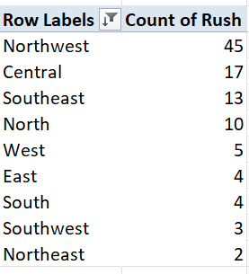
2
By filtering out the Rush column as “Yes” and by using a pivot table keeping Districts as rows and Rush as values, we get the data.
According to the data Northwest District has the highest rush jobs which is 45.

Slide 4
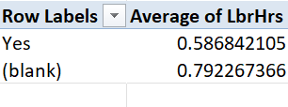

3
The average Labour hours for Rush jobs are 0.59 and for Non rush jobs it is 0.79.
Basically, there is a massive difference between the count of Rush job and Non rush job.
So, the labour hours is respective of its own amount of work as well.

Slide 5
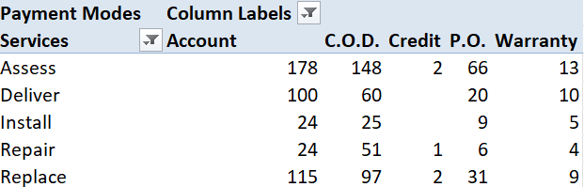
4
There are totally 5 types of services and 5 types of Payment modes.
Assess Service is the service type that is widely being used.
Account payment is the most used Payment type and next comes the C.O.D.
Atlast we have the Credit payment which has only 5 payments in total.

Slide 6
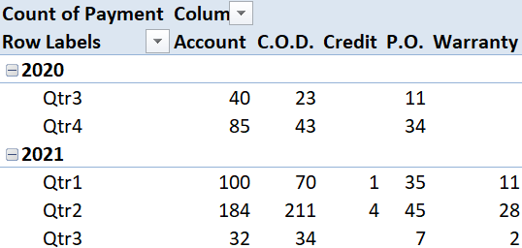
5
All the payment modes seems to be rising over the years.
We can observe from the bar graph that both C.O.D and Account payment has risen rapidly.
The P.O and Credit payment methods hasn’t been used in the year 2020. But people started getting familiar with that payment mode in the year 2021.

Slide 7
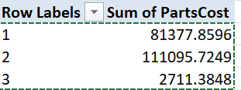
6
The number of technicians should be selected as Row column in the pivot table and the Sum of PartsCost as column.
Using the correl() function we get the correlation value as 24% which is a mild correlation between the Technicians and Parts Cost.
The Scatter plot also shows that there is a mild correlation.

Slide 8
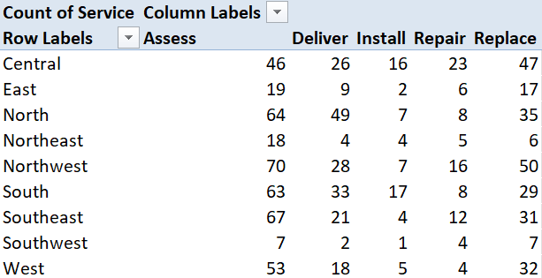
7
By taking the result from Pivot table and Bar graph by selecting Districts as Rows, Service as column and Count of Service as values we can conclude that Assess Service is the most requested type of service in each district.

Slide 9
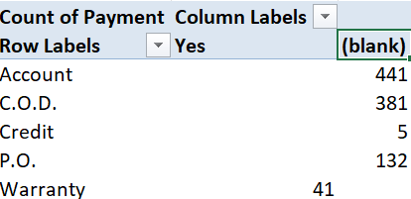
8
The labours who has warranty is paid only from the Warranty payment mode.
No other mode is being used to pay the labours with warranty.
So, there is a huge difference amongst Payment modes and labours with and without warranty.

Slide 10
